Slide 1

Title: Enhancing Operational Efficiency in a Multi-Specialty Hospital
Name: Aryan Dave
Designation: Business Analyst

Slide 2

Case study overview
You have recently been hired as a Business Analyst by HealthFirst Care, a leading multi-specialty hospital renowned for its high-quality patient care and advanced medical facilities.
The hospital has launched an initiative to enhance the overall patient experience in light of increasing patient complaints and operational challenges.

Slide 3
Case study overview
The management has identified key areas for improvement, including:
Reducing wait times
Optimizing resource allocation
Improving communication between stakeholders

Slide 4





Task overview
As a Business Analyst, you have been tasked with driving this initiative. Your role will involve:
Gathering stakeholder requirements
Analyzing existing processes
Developing data-driven solutions to improve operational efficiency
Developing risk assessment and mitigation plan

Slide 5

Task 1
Task 1

Slide 6
Business Requirement Document (BRD)
A BRD defines the business objectives, project scope, key requirements, stakeholder expectations, and deliverables for a project.
Problem statement
Key requirements to improve operational efficiency
Constraints
Acceptance criteria
HealthFirst Care is experiencing challenges in appointment scheduling, leading to patient dissatisfaction, inefficient record management, poor communication between departments, and difficulties in resource allocation.
Improve online appointment system.
Enhance Resource allocation.
Improve inter departmental communication.
Streamline patience records system.
Improve Billing process.
Budget limitations for system upgrades.
Staff resist to change.
Lack of sufficient skills in IT Team.
Frequent Downtime.
Interruption in operations.
95% appointment confirmation; 90% fewer booking issues.
100% resource availability; 80% fewer conflicts.
Real-time updates; 90% handoffs without delay.
95%+ data accuracy; 95% digital referrals.
90% fewer billing errors; 25% faster processing.

Slide 7
Task 1
Task 2

Slide 8
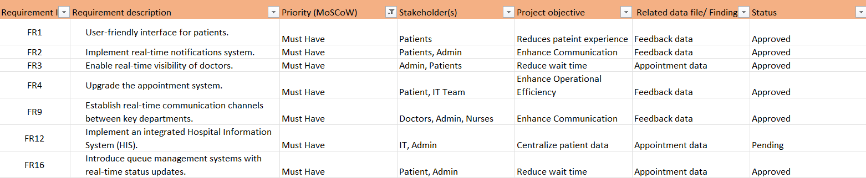
Requirement Traceability Matrix (RTM)
A Requirements Traceability Matrix maps and tracks project requirements throughout the lifecycle, ensuring that each requirement is addressed, tested, and aligned with business objectives, stakeholder needs, and project deliverables.
Categorize requirements into functional and non-functional
Categorize requirements using the MoSCoW method
List requirements based on priority
Sample of high-priority (Must Have) requirements; full RTM includes all priority levels.

Slide 9
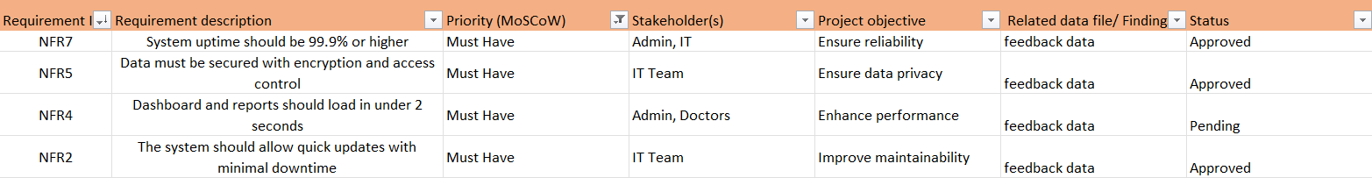
Requirement Traceability Matrix (RTM)
Categorize requirements into functional and non-functional
Categorize requirements using the MoSCoW method
List requirements based on priority
Sample of high-priority (Must Have) requirements; full RTM includes all priority levels.

Slide 10
Task 1
Task 3

Slide 11
Stakeholder Analysis and Engagement Plan
The Stakeholder Analysis and Engagement Plan identifies key stakeholders, understands their interests and influence, and develops strategies to effectively communicate, engage, and manage their expectations throughout the project lifecycle.
Identifying and documenting stakeholders
Categorizing stakeholders’ influence as high or low.
Listing stakeholder engagement strategies
Noting stakeholder communication strategies
Patients
Doctors/Nurses
Administrative Staff
IT teams
Hospital leadership
Low
High
High
High
High
Newsletters, dashboards, surveys
Regular meetings, detailed reports
Regular meetings, detailed reports
Periodic updates
Periodic updates
Newsletters, dashboards, surveys
Meetings, progress reports
Meetings, progress reports
Email
Email

Slide 12
Task 1
Task 4

Slide 13
Scope Management Plan
The Scope Management Plan defines how the project scope will be planned, documented, validated, and controlled to ensure that all project objectives and deliverables are met while preventing scope creep.
Categorizing scope into in-scope & out-of-scope
Identifying assumptions and constraints
In-scope activities
1. Improve online appointment system.
2. Enhance Resource allocation.
3. Improve inter departmental communication.
4. Streamline patience records system.
5. Improve Billing process.
Assumptions
Patients have device access
Budget approvals secured
Staff training included
No major regulatory changes
IT infrastructure is compatible
Departmental participation assured
Out-of-scope activities
1. Redesign Website.
2. Building new facilities.
3. Recruit more nurses.
Constraints
Budget limitations for system upgrades.
Staff resist to change.
Lack of sufficient skills in IT Team.
Frequent Downtime.
Interruption in operations.

Slide 14
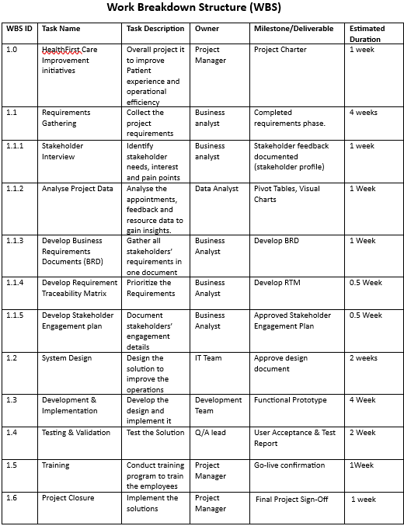
Defining phases in the Work Breakdown Structure (WBS)
Note Scope Change Management
All change requests must be submitted formally (email or document)
Reviewed by Project Manager for relevance and feasibility
Evaluated for impact on goals, timeline, and budget
Final decision made by Hospital Leadership
Approval based on patient impact, cost, and timeline fit
Change log maintained for tracking approvals and rejections

Slide 15
Task 1
Task 5

Slide 16
Process Map Diagrams
The Process Map Diagrams visually represent the workflow of a system or process, identifying inefficiencies, redundancies, and areas for improvement to enhance operational efficiency and decision-making. You are required to fill the table with processes along with inefficiencies identified using the As-Is model and areas of improvements identified using the To-Be model:
Process | As-Is model | To-Be model
Appointment Scheduling | Manual booking process causes delays - Slot availability not updated in real-time - Confirmation delays due to manual follow-ups | - Automated online booking system - Real-time slot availability - Instant confirmation via SMS/email
Patient Check-In | - Paper-based check-in at front desk - Long queues due to manual entry - No task visibility for medical staff | - Self-service kiosks/digital check-in - Reduced wait time - Task dashboard for doctors and nurses
Interdepartmental Communication | -Delayed communication between departments - Lack of updates during patient transfer - No standard process for handoffs | - Implement interdepartmental communication system - Real-time updates - Standardized handover protocols

Slide 17
Task 1
Task 6

Slide 18
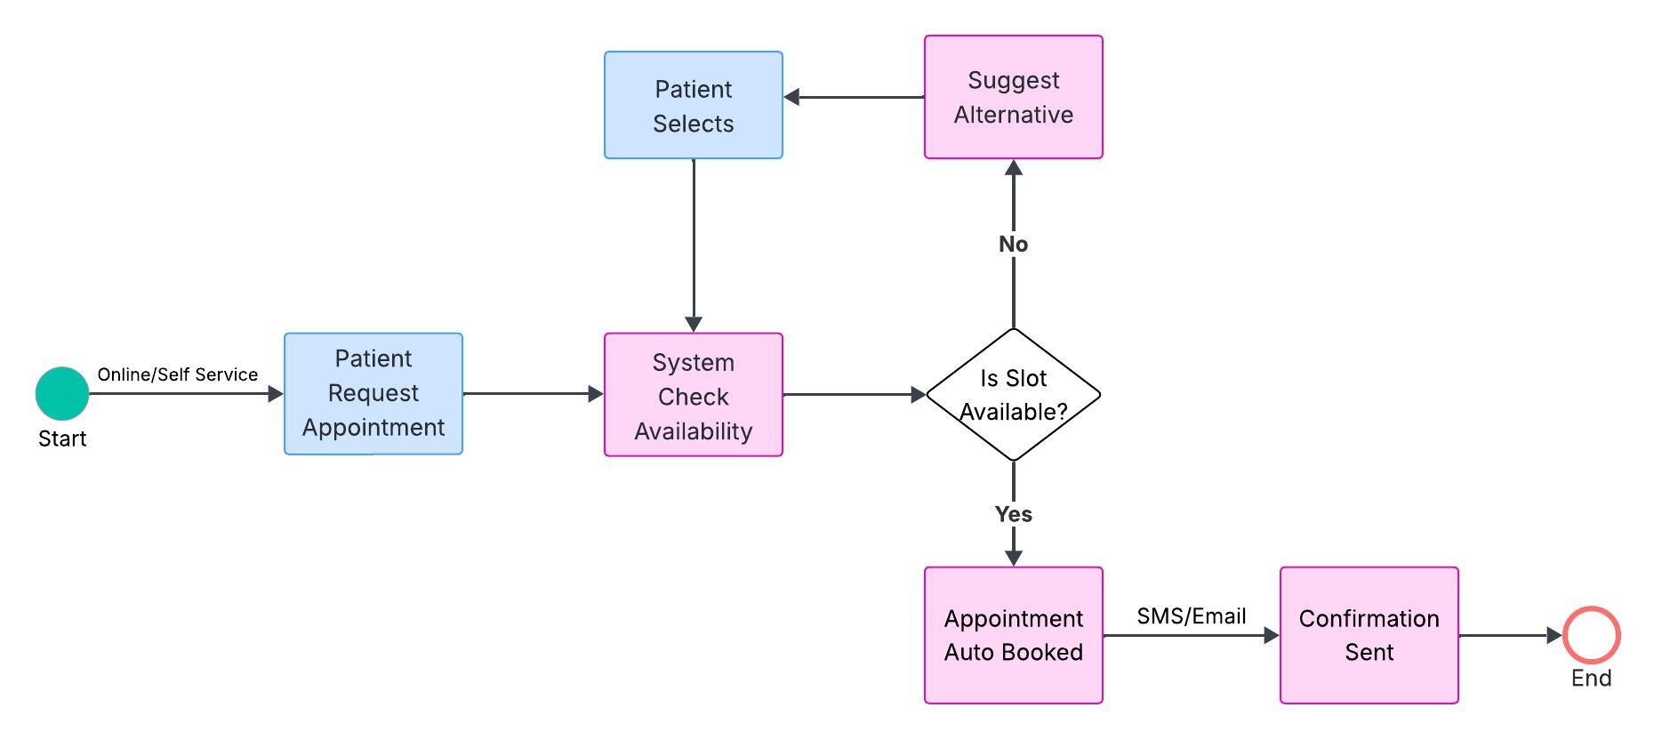
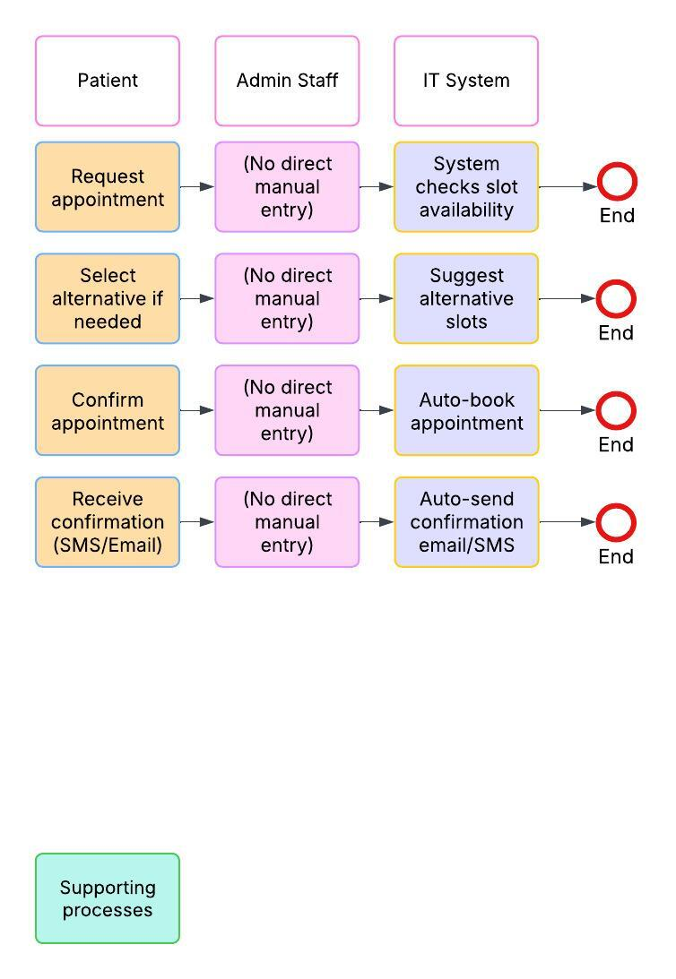
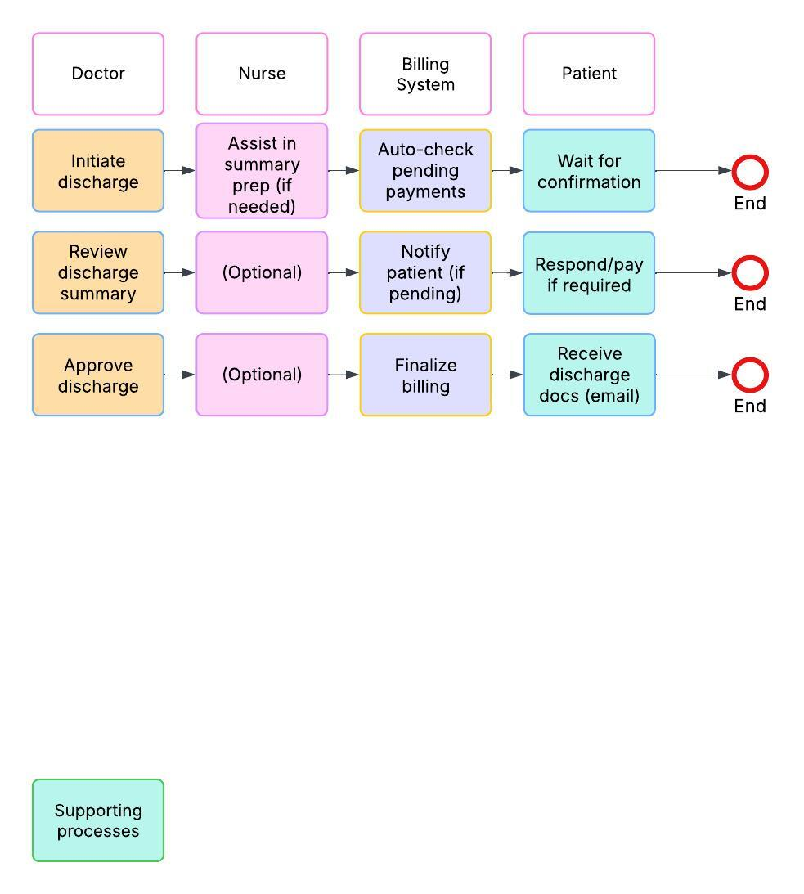
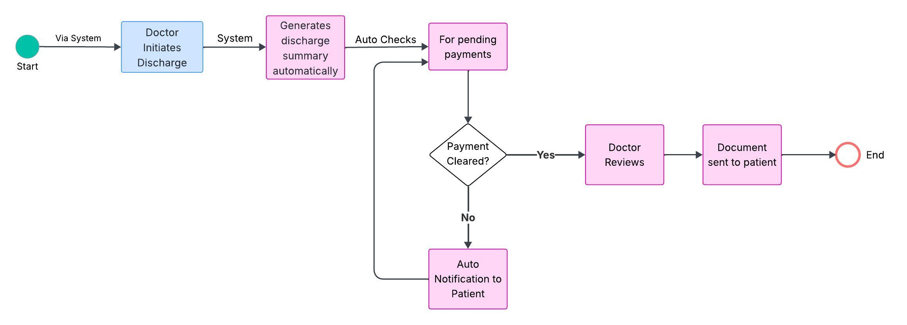
BPMN and Swimlane Diagrams
BPMN and Swimlane diagrams provide a structured visual representation of business processes, clarifying roles, responsibilities, and interactions among different stakeholders to enhance workflow efficiency and communication.
Workflow using Advanced BPMN Model
Stakeholder responsibilities using Swimlane diagram
:
Appointment Scheduling (To-Be)
Appointment Scheduling (To-Be)
Patient Discharge (To-Be)
Patient Discharge (To-Be)

Slide 19
Task 1
Task 7

Slide 20
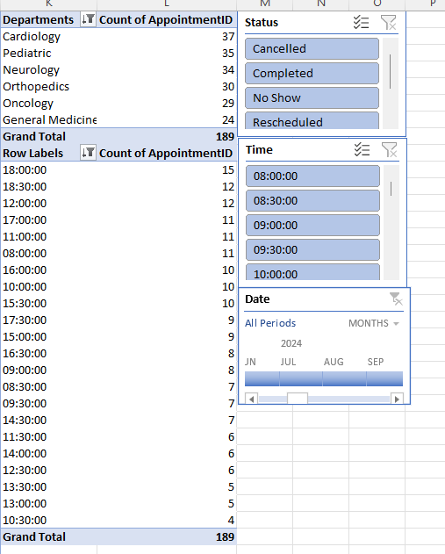
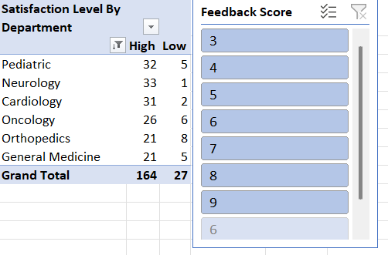
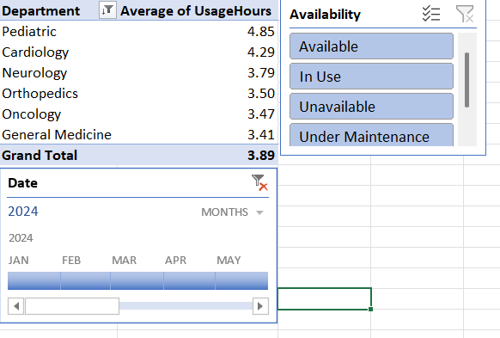
Data Analysis Document
The Data Analysis Document summarizes the key findings, trends, and insights derived from patient and resource data, providing evidence-based recommendations to enhance hospital operations and patient satisfaction.
Trends identified using Pivot Table

Slide 21
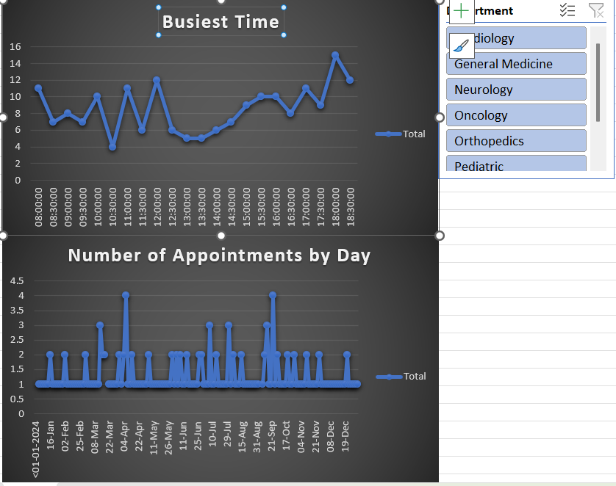
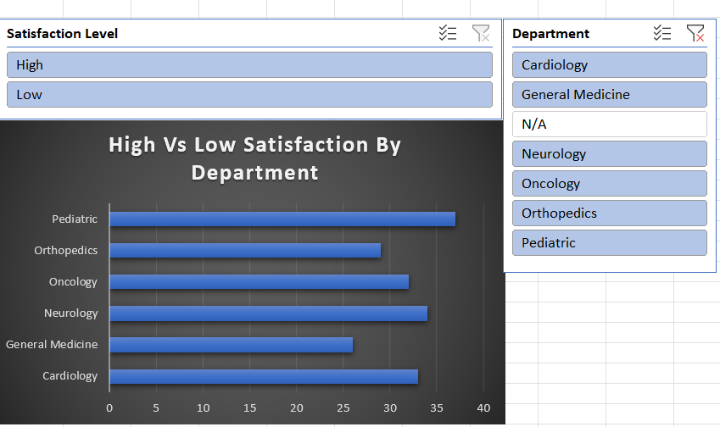
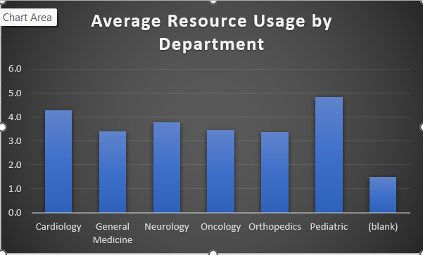
Analyzed trends

Slide 22
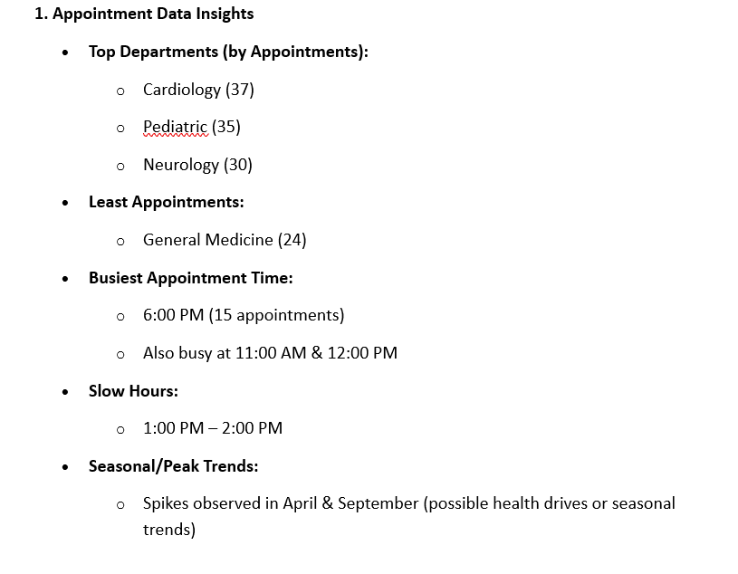
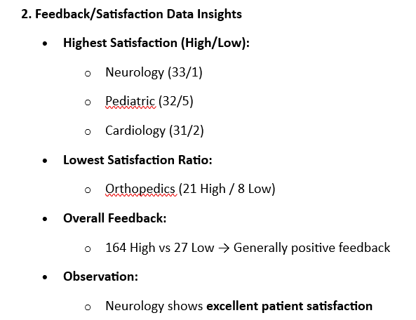
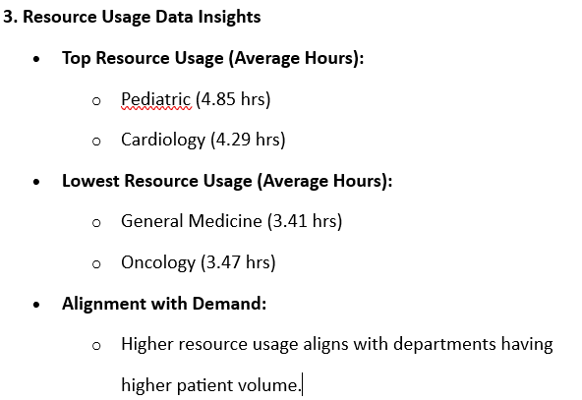
Key insights
[Add your screenshot here]

Slide 23
Task 1
Task 8

Slide 24
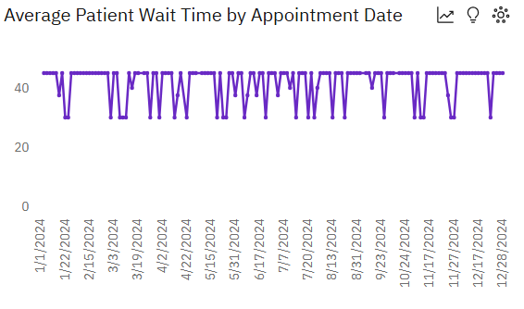
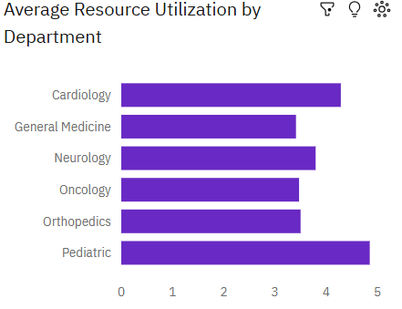
Dashboard
Dashboards visualize key operational metrics, such as patient wait times, resource utilization, and staff productivity, enabling data-driven decision-making for improved hospital efficiency and patient experience.
Average patient wait time using a Line Chart
Bar Chart highlighting overused and underutilized resources

Slide 25
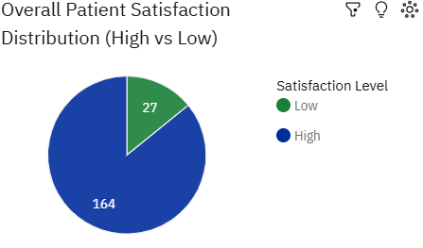
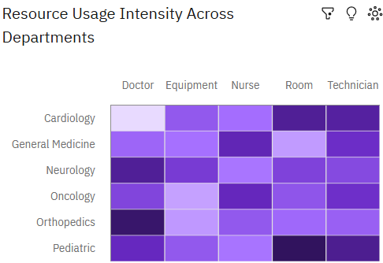
Dashboard
Patient feedback visualized using a Pie Chart
Heat Map showing the efficiencies of the departments
[Add your screenshot here]

Slide 26
Task 1
Task 9

Slide 27
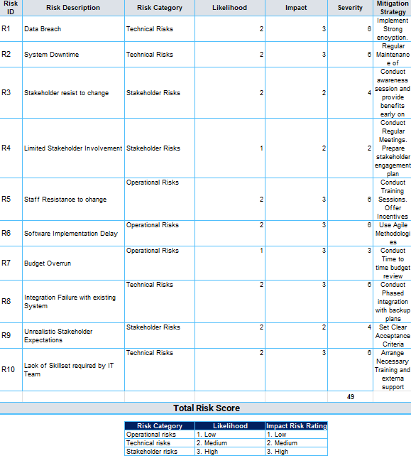
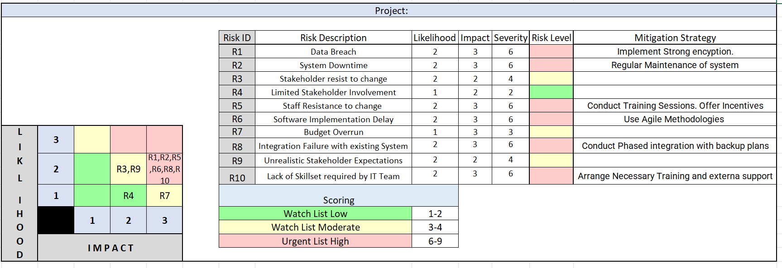
Risk Management Plan
The Risk Management Plan identifies, assesses, and mitigates potential risks—such as data privacy concerns, system integration challenges, and operational inefficiencies—to ensure smooth project execution and improved patient care.
Risks identified in the risk register
Categorized risks based on the Risk Assessment Matrix
[Add your screenshot here]

Slide 28
Elements identified in the SWOT Analysis
Key insights
Data security is a top risk — use encryption and audits.
Staff resistance may slow progress — training and incentives are needed.
IT skill gaps can cause delays — provide early upskilling.
System integration has high risk — use phased rollout and backups.
Budget overruns are possible — monitor spending regularly.
Low stakeholder involvement can harm progress — conduct regular meetings.
Not all risks are high, but even low risks should be tracked.
Strength (Internal)
Strong leadership support.
Qualified and Experienced Medical Staff.
Highly skilled IT Team.
Existing experience with healthcare operations
Opportunity (External)
Process automation.
Enhance patient satisfaction.
Staff upskilling and digital literacy programs.
Use of data for decision-making and future improvements
Weakness (Internal)
Manual workflows in appointment and check-in processes.
Lack of effective inter-department communication.
Inefficient resource allocation.
Limited digital skills and dependence on manual processes.
Threats
Data security risks (data breaches).
Stakeholder resistance to change.
Budget overruns during implementation.
Potential integration challenges with existing hospital IT systems.

Slide 29
Task 1
Task 10

Slide 30
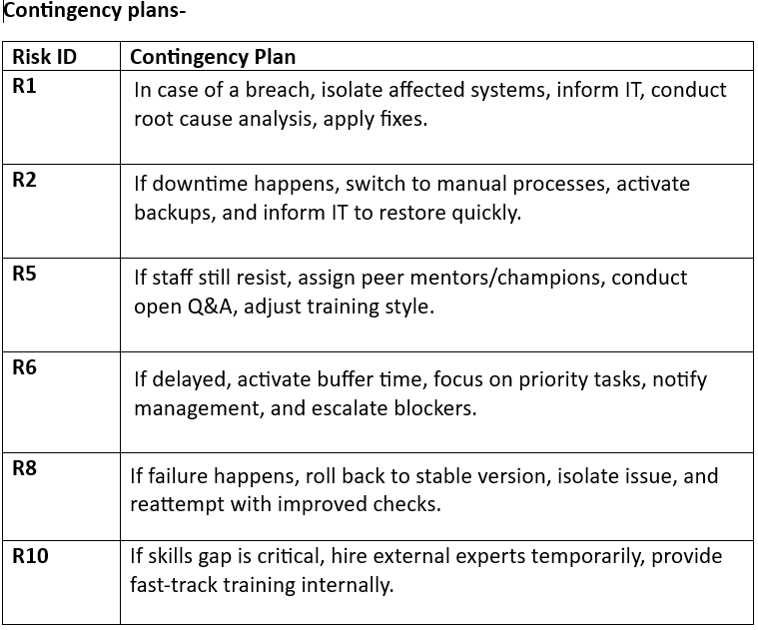
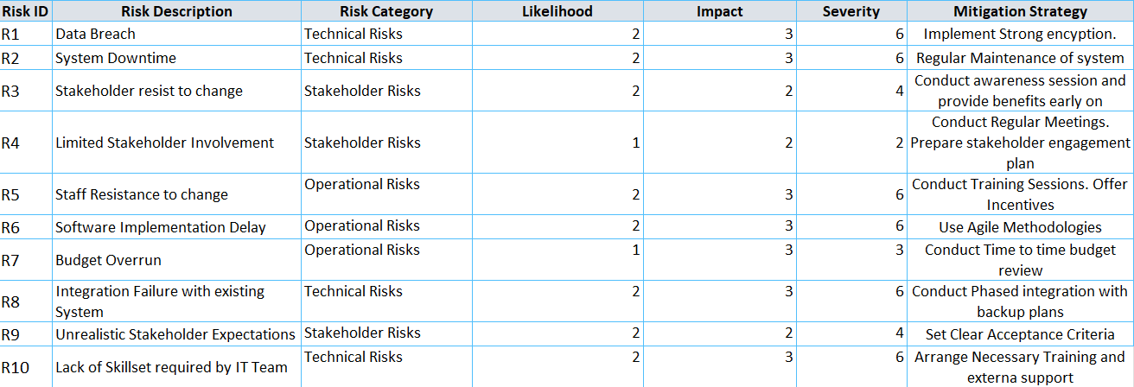
Risk Mitigation Plan
The Risk Mitigation Plan identifies potential risks, assesses their impact, and implements strategies to minimize disruptions, ensuring smooth hospital operations and improved patient care.
Strategies to mitigate risks
Factors included in your Contingency Plan
[Add your screenshot here]
[Add your screenshot here]

Slide 31
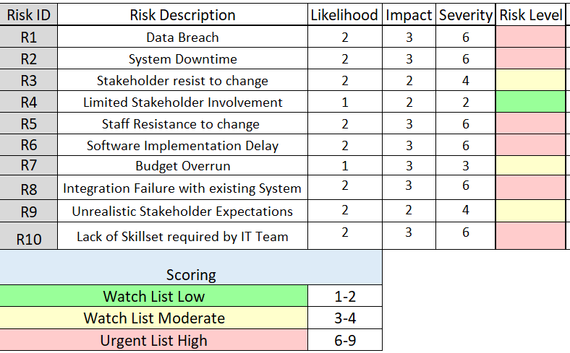
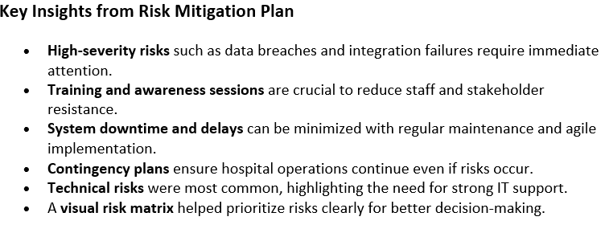
Prioritized risks based on Visual Risk Matrix
Key insights from Risk Mitigation Plan

Slide 32
Conclusion
The proposed solutions for HealthFirst Care aim to enhance operational efficiency, improve patient satisfaction, and streamline internal processes. Through detailed requirement gathering, process analysis, and data-driven insights, the project identifies key areas of improvement such as appointment scheduling, resource allocation, and interdepartmental communication.
By implementing modern systems, ensuring stakeholder alignment, and applying risk mitigation strategies, the hospital is well-positioned to deliver faster, more reliable, and patient-centered care. These improvements will lead to reduced wait times, better resource utilization, and an overall improvement in the quality of healthcare services.

